Slide 1
Customer Behavior Analysis using
Marketing Campaign Dataset
IS 407 – Introduction to Data Science
12/06/2023

Slide 2
Agenda
Project description
Literature Survey
Methodology
Research Questions
Limitations
Future Scope
References

Slide 3

Introduction
Marketing Campaign : Coordinated efforts for product, service, or brand promotion with specific goals
Strategic Initiative: Involves planning and identifying target demographics for effective influence
Diverse Goals: Aims at increasing sales, enhancing brand awareness, engaging customers, or launching new products
Amazon Prime Day Example:
Annual event by Amazon
Objective: Drive sales via exclusive deals
Targets: Amazon Prime members and new customers
Campaign Impact: Demonstrates strategic planning with a focus on clear goals and targeted audience engagement

Slide 4
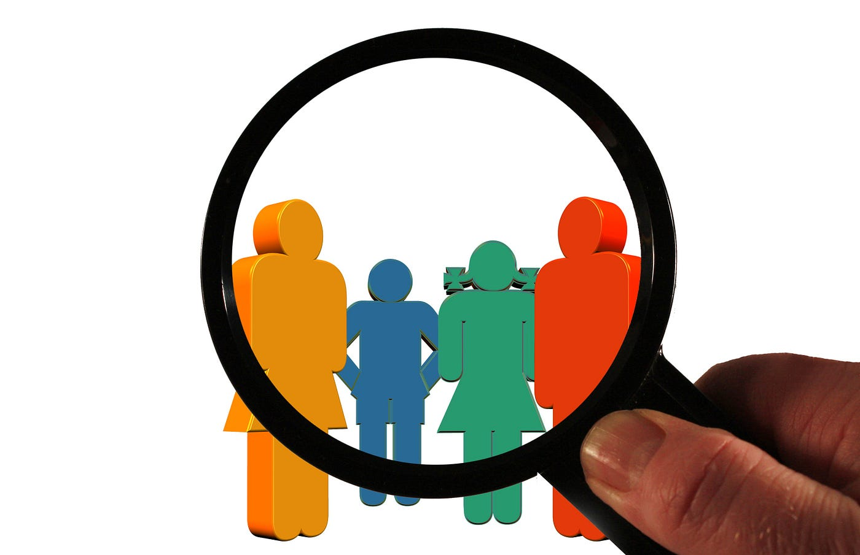
Project Description
Employed various statistical methods to analyze campaign data
Understand customer behavior and identify correlations between variables influencing sales
Improve campaign outcomes using data-driven insights
Make calculated decisions for future campaigns
Optimize resource allocation for more effective campaigns
DATASET
Imported Marketing Campaign dataset from Kaggle
KEY COLUMNS-
Demographics: Education, Marital Status
Financial Information: Income
Purchase Behavior: Days since last purchase, amounts spent on various products
Engagement Metrics: Number of visits and purchases

Slide 5
Literature Review
Al-Dabbas et al. (2023): K-Means Clustering for Customer Personality Segmentation
Leveraged K-means clustering for customer segmentation
Aimed to enhance customer understanding and modify products to cater to specific needs, behaviors, and interests
Emphasized the effectiveness of clustering for tailored marketing strategies
Highlighted the significance of unsupervised learning in gaining valuable insights
Relevance to our study
Utilization of statistical methods for finding trends in different consumer groups.
Stressing the importance of demographic information analysis.
Emphasis on shaping targeted marketing strategies based on demographic factors and purchasing behavior.

Slide 6
Sr. No. | Research Questions
1 | How does the spending on different product categories vary with income?
2 | How does the level of education influence customer acceptance in marketing campaigns?
3 | Do customers with different numbers of small children in their households exhibit significantly different levels of spending on sweet products?
4 | Are there any trends or changes in campaign acceptance rates over time?
5 | Do customers exhibit different spending patterns during specific seasons?
Research Questions

Slide 7
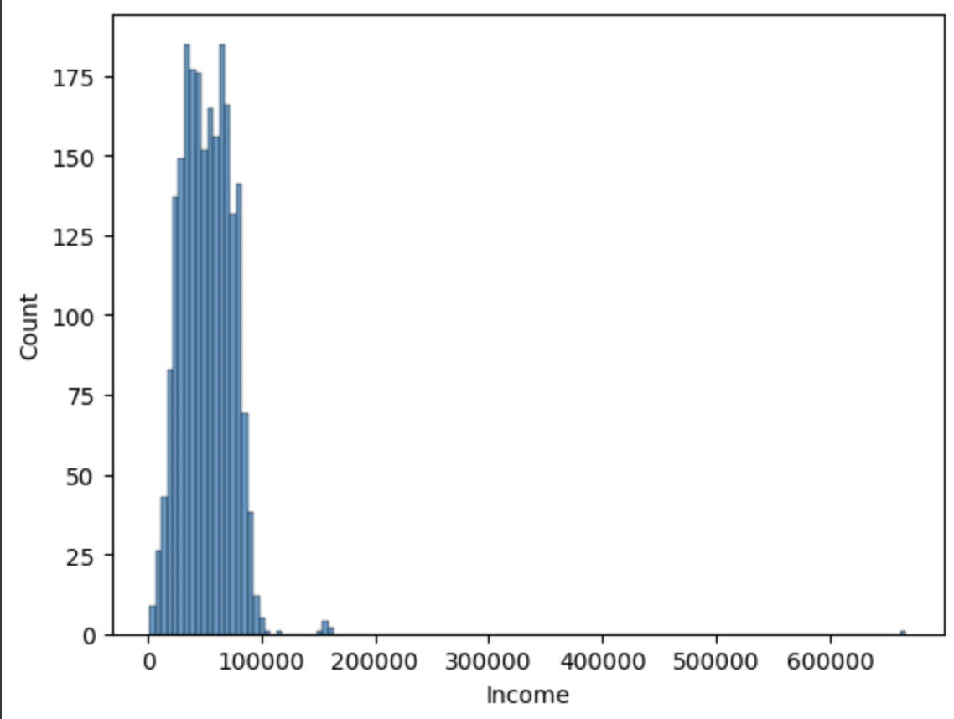
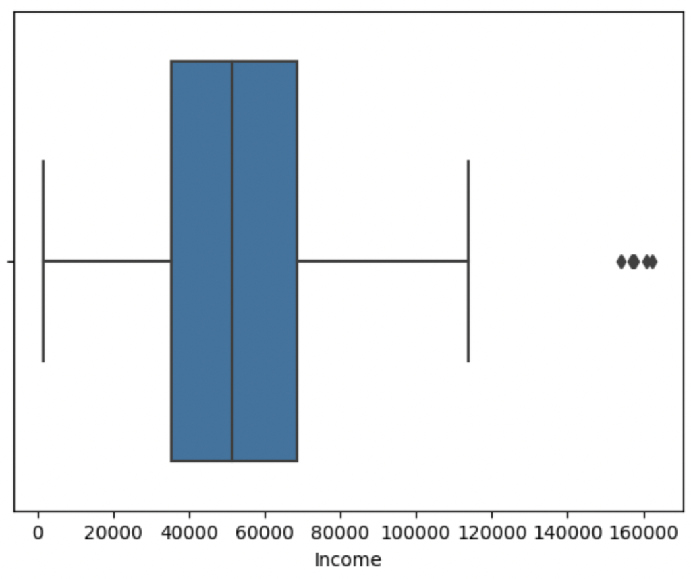
Basic Dataset Cleaning
Before proceeding with the research questions, the dataset required basic cleaning.
Apart from removing the null values, box plot was plotted to identify the outliers.
The outliers were then removed for better analysis.
Checking distribution of income
Boxplot

Slide 8
How does the spending on different product categories vary with income?
01

Slide 9
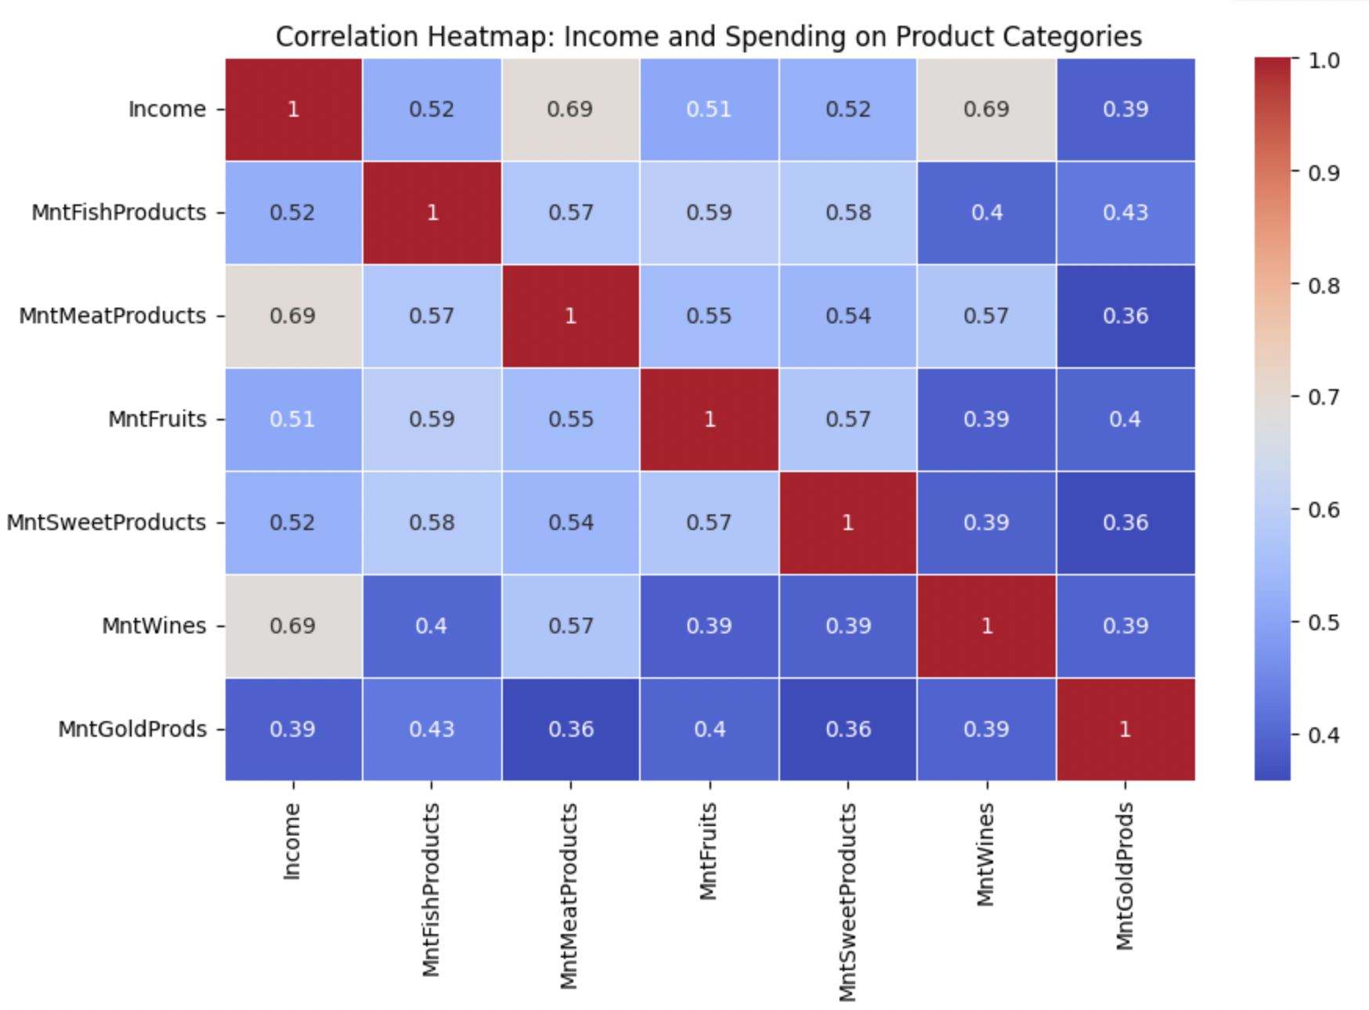
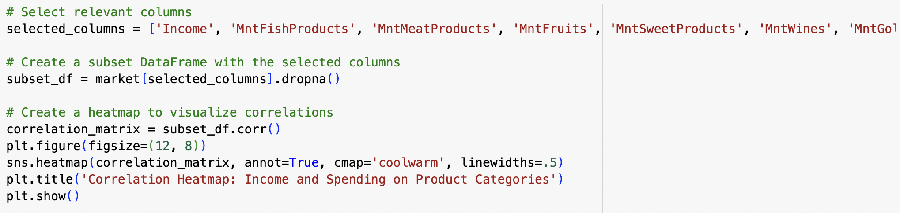
Analysis

Slide 10
How does the level of education influence customer acceptance in marketing campaigns?
02

Slide 11
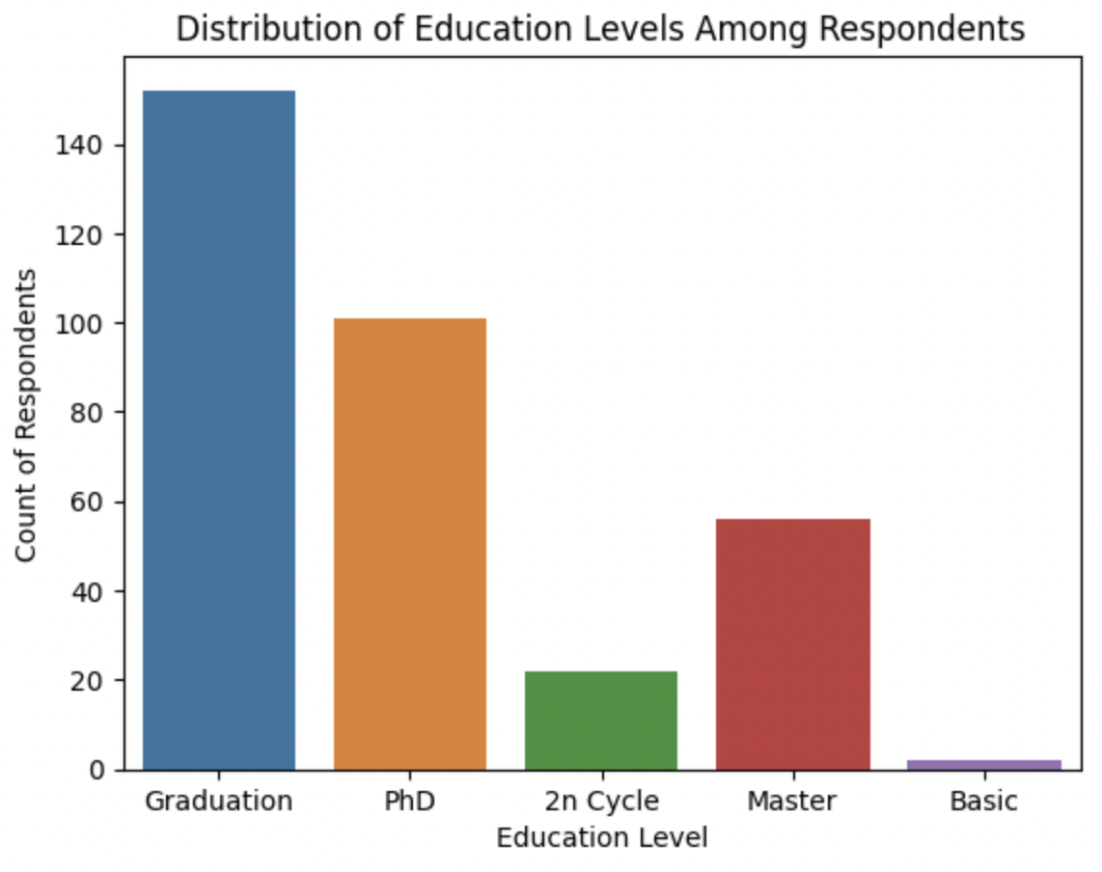
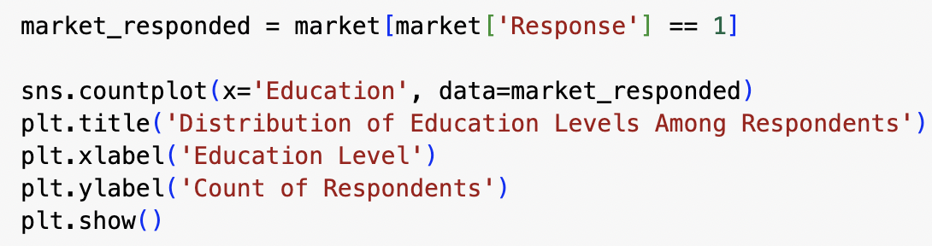
Analysis & Visualization

Slide 12
Do customers with different numbers of small children in their households exhibit significantly different levels of spending on sweet products?
03

Slide 13
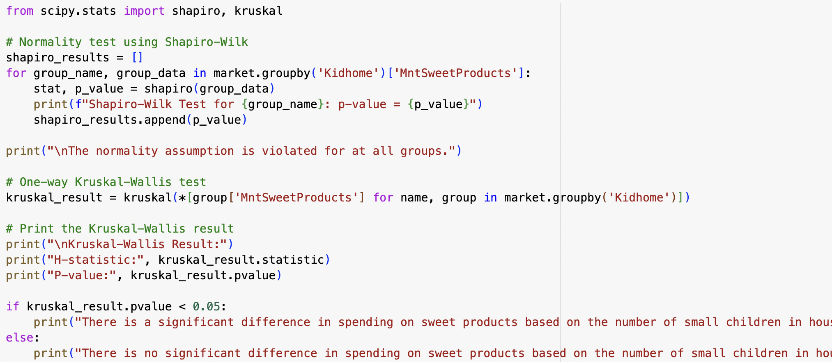
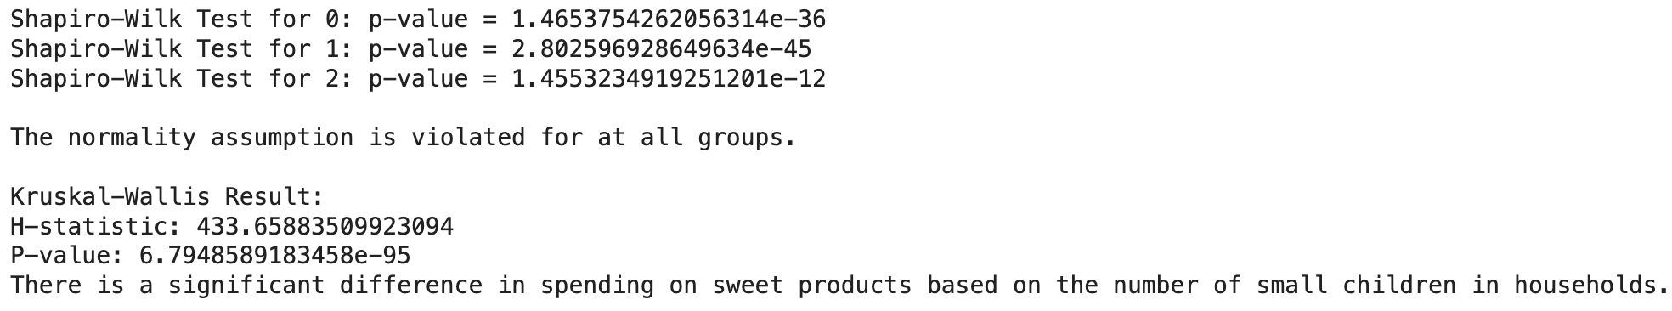
Analysis

Slide 14
Are there any trends or changes in campaign acceptance rates over time?
04

Slide 15
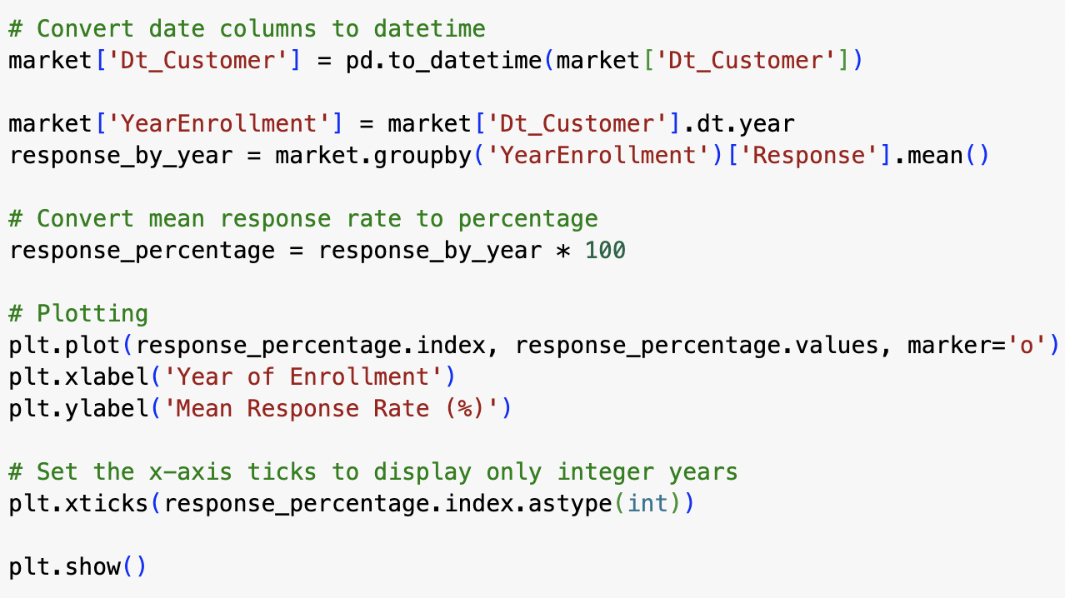
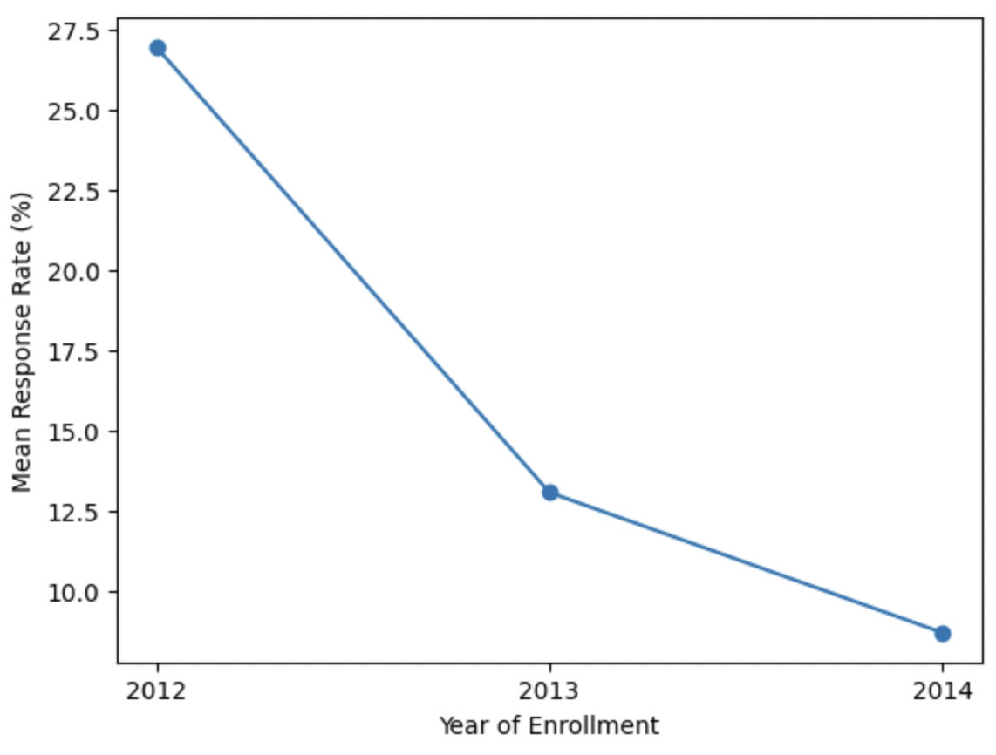
Analysis & Visualization

Slide 16
Do customers exhibit different spending patterns during specific seasons?
05

Slide 17
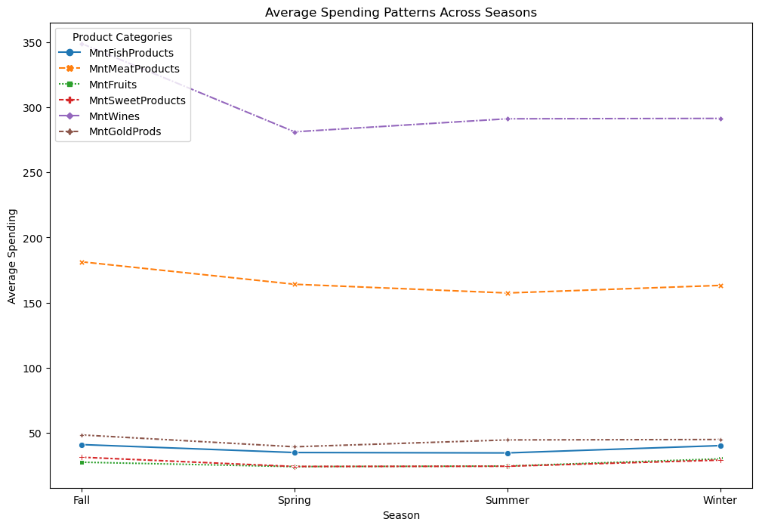
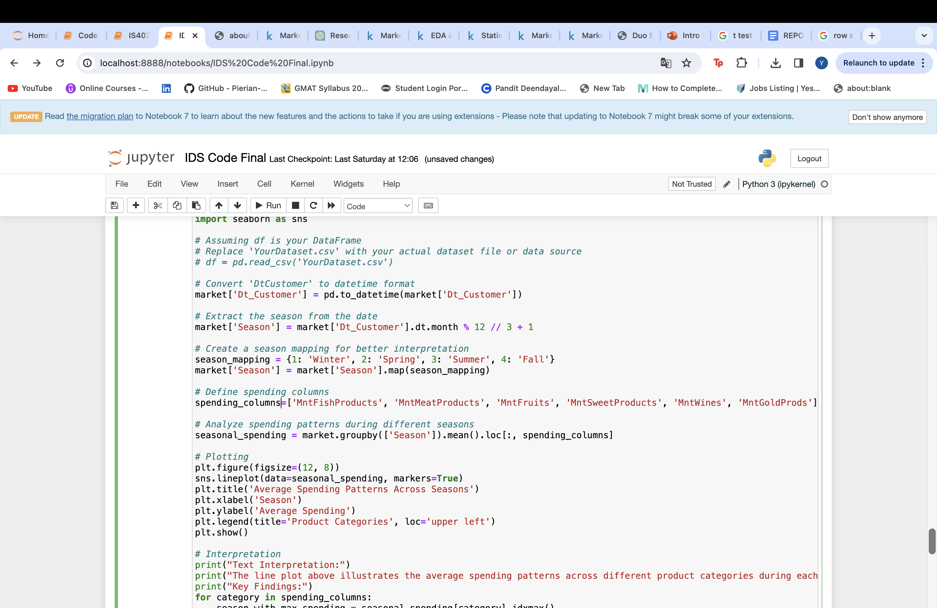
Analysis

Slide 18
Limitations:
Correlations are observed, but we can't conclude direct cause-and-effect relationships. Results depend on how good and unbiased our data.
Dataset's breadth may not encompass all customer behaviors, and inherent biases may occur. To overcome these constraints, future iterations of this study should broaden the dataset to include a wider spectrum of dataset, clients
Our data set included data for just 3 years, the more data, better would be the analysis and better insights
Data Dependence and Bias
Limited Data
Less Variety of Variables

Slide 19
Conclusion
Strategic Navigation: Navigate businesses through intricate consumer behaviors for effective marketing strategies.
Dynamic Customer Insights: Unveil diverse customer behaviors, providing a foundation for precise and dynamic strategy tailoring.
Optimizing Marketing: Emphasize the adoption of adaptable and innovative techniques for ongoing optimization in a dynamic market landscape.
Targeting Graduates & Families: Highlight the significance of targeting graduates and designing promotions aligned with diverse family dynamics for impactful campaigns.
Strategic Marketing Insights: Provide strategic insights by correlating income, education, family dynamics, trends, and seasonal patterns, empowering businesses to refine marketing strategies for maximum impact.

Slide 20
Future Scope
Collect data to make sure it's more accurate and unbiased.
Break down spending on products more precisely to get a clearer picture of what customers really like.
External factors influencing consumer behavior can be considered in this analysis might be investigated.
Extend our analysis over multiple campaigns to see how customer behavior changes.

Slide 21
References
[1] Basu, R., Lim, W. M., Kumar, A., & Kumar, S. (2023). Marketing analytics: The bridge between customer psychology and marketing decision-making. Psychology & Marketing, 1–24. https://doi.org/10.1002/mar.21908
[2] K. Bhade, V. Gulalkari, N. Harwani and S. N. Dhage, "A Systematic Approach to Customer Segmentation and Buyer Targeting for Profit Maximization," 2018 9th International Conference on Computing, Communication and Networking Technologies (ICCCNT), Bengaluru, India, 2018, pp. 1-6, doi: 10.1109/ICCCNT.2018.8494019.
[3] L. Al-Dabbas, H. Al-Tarawneh and T. A. Al-Rawashdeh, "Customer Personality Segmentation Using K-Means Clustering," 2023 International Conference on Information Technology (ICIT), Amman, Jordan, 2023, pp. 537-543, doi: 10.1109/ICIT58056.2023.10225996.

Slide 22
THANK YOU!

